Slide 1
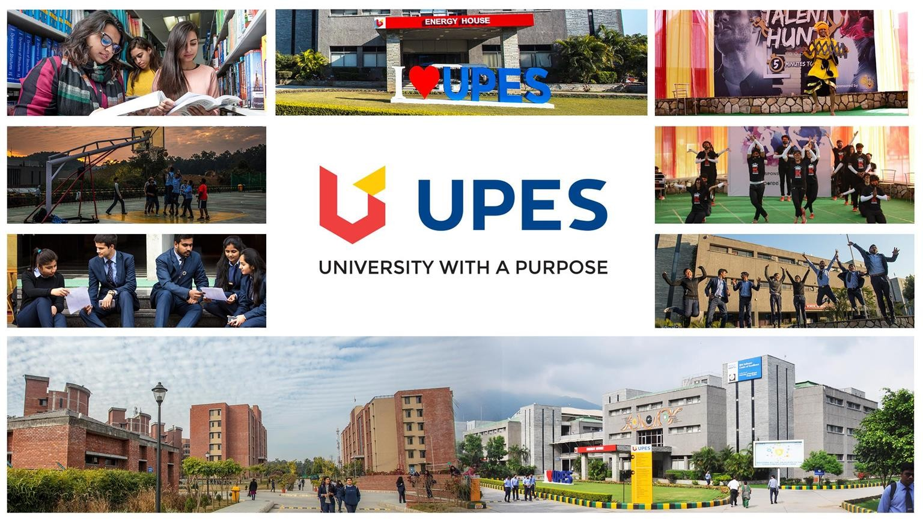

Slide 2
Gesture recognition using open CV

Slide 3
Under the guidance of
Dr. Rashmi Sharma
Assistant Professor (SG), Department of Systemics
SOCS, UPES
Submitted By
Arun Tomar | 500067402 | R110218034
Chirag Sharma | 5000 | R11021
Divyansh Thakur | 500067098 | R112018052
Atul Garg | 500068649 | R110218037

Slide 4
INTRODUCTION
A few decades ago, using computers was so hard and complex that none however scientists could use it. But now with the passage of time and to deal with the call for our every sphere of existence, usage of computer has end up so easy that everybody can use it. At present, a mouse or keyboard is being used to interact with the computer. Sometimes it seems uncomfortable because people don’t want to get off from where they are sitting or lying. A gesture recognition system provides a natural, innovative, and modern way of non-verbal communication.
Gesture is a sign of physical behavior or an expression of feelings. This involves the movement of the body and hand. It fell into two categories: static gesture and fluid gesture; for the former, body posture or hand gesture denotes a symbol.
Our goal is to create a system that can identify specific human gestures and use them to convey information for device control and by implementing real-time gestures recognition a user can control a computer by doing a specific gesture in front of a video camera linked to a computer. Here the system can be operated using hand gestures without using keyboard and mouse.

Slide 5
PROBLEM STATEMENT
With the advancement of computer current user interaction approaches with input devices are not sufficient.
Due to the limitation of these devices the useable command set is also limited. Direct use of gesture can be used as an input device for providing natural interaction.
To give a system to government to aid the injured army personnel during line of duty and to aid the bedridden patients in the hospitals.

Slide 6
OBJECTIVE
To establish people friendly system to aid in the ease of living of the challenged people.
To establish a complete system for detecting, recognizing and interpreting gesture recognition through computer vision using Python and OpenCV techniques.

Slide 7
ALGORITHM
Otsu Thresholding Algorithm
The segmentation of gray scale image of a hand gesture is performed using Otsu thresholding algorithm.
It treats any segmentation problem as classification problem.
Total image level is divided into two classes one is hand and other is background.
Threshold value is determined by computing the ratio between class variance and total class variance.
A filtering method is used to effectively remove background and object noise in the segmented image.
This method consists of opening, and closing operations.

Slide 8
AI Virtual Mouse
Developed an AI-based approach for controlling the mouse movement using Python and openCV with real-time camera that detects hand landmarks, tracks gesture patterns instead of a physical mouse.
AI virtual mouse system makes use of the hand gestures and hand tip detection for performing mouse functions in the computer using computer vision.
The AI virtual mouse system is useful for many applications; it can be used to reduce the space for using the physical mouse, and it can be used in situations where we cannot use the physical mouse. The system eliminates the usage of devices, and it improves the human-computer interaction..

Slide 9
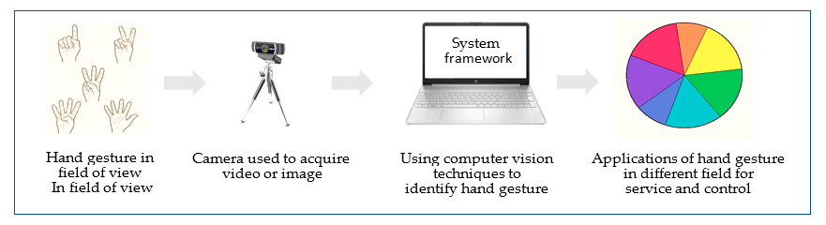
SYSTEM FLOW
Fig :-Using computer vision techniques to identify gestures. Where the user perform specific gesture by single or both hand in front of camera which connect with system framework that involve different possible techniques to extract feature and classify hand gesture to be able control some possible application

Slide 10
TECHNOLOGIES USED
Software Required | System Required | Libraries
Operating System: Window Technology: Python, py charm | Processor: Intel i3 Hard Disk: 40 GB RAM: 8 GB Camera | Media pipe Numpy Open Cv autopy

Slide 11
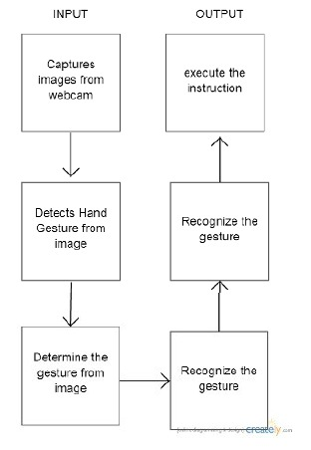
APPLICATION WORKFLOW

Slide 12
SWOT ANALYSIS
THREATS
* When parsing a JSON file and encountering a null byte, OpenCV copies to the buffer the entire value up to that point. This help attacker to easily attack the system.
* Gesture limitation is a issue as if we want to add a new gesture then in that case we have to train whole data again.
STRENGTH
* There are a lot of API’s SDK’s online that help build such a system.
* Footage can be recorded to be manually checked.
WEAKNESS
* It depends on the distance and pose of the face as well as the quality, illumination of the image/video used.
* It is slow if it does not use a live video footage for recognition.
OPPORTUNITIES
*It shows a potential growth in the market.
* It helps in checking the different aspects of gestures leading to adding newer functionalities.

Slide 13
AREA OF APPLICATION
This algorithm has many area of applications like:
Virtual reality: It can simulate physical presence in places in the real world, as well as in imaginary worlds.
Sign Language: It’s used in sign language like A simple gesture with one hand has the same meaning all over the world and means either ’hi’ or ‘goodbye’.
3D Design: CAD (computer aided design) is an HCI which provides a platform for interpretation and manipulation of 3-Dimensional inputs which can be the gestures.

Slide 14
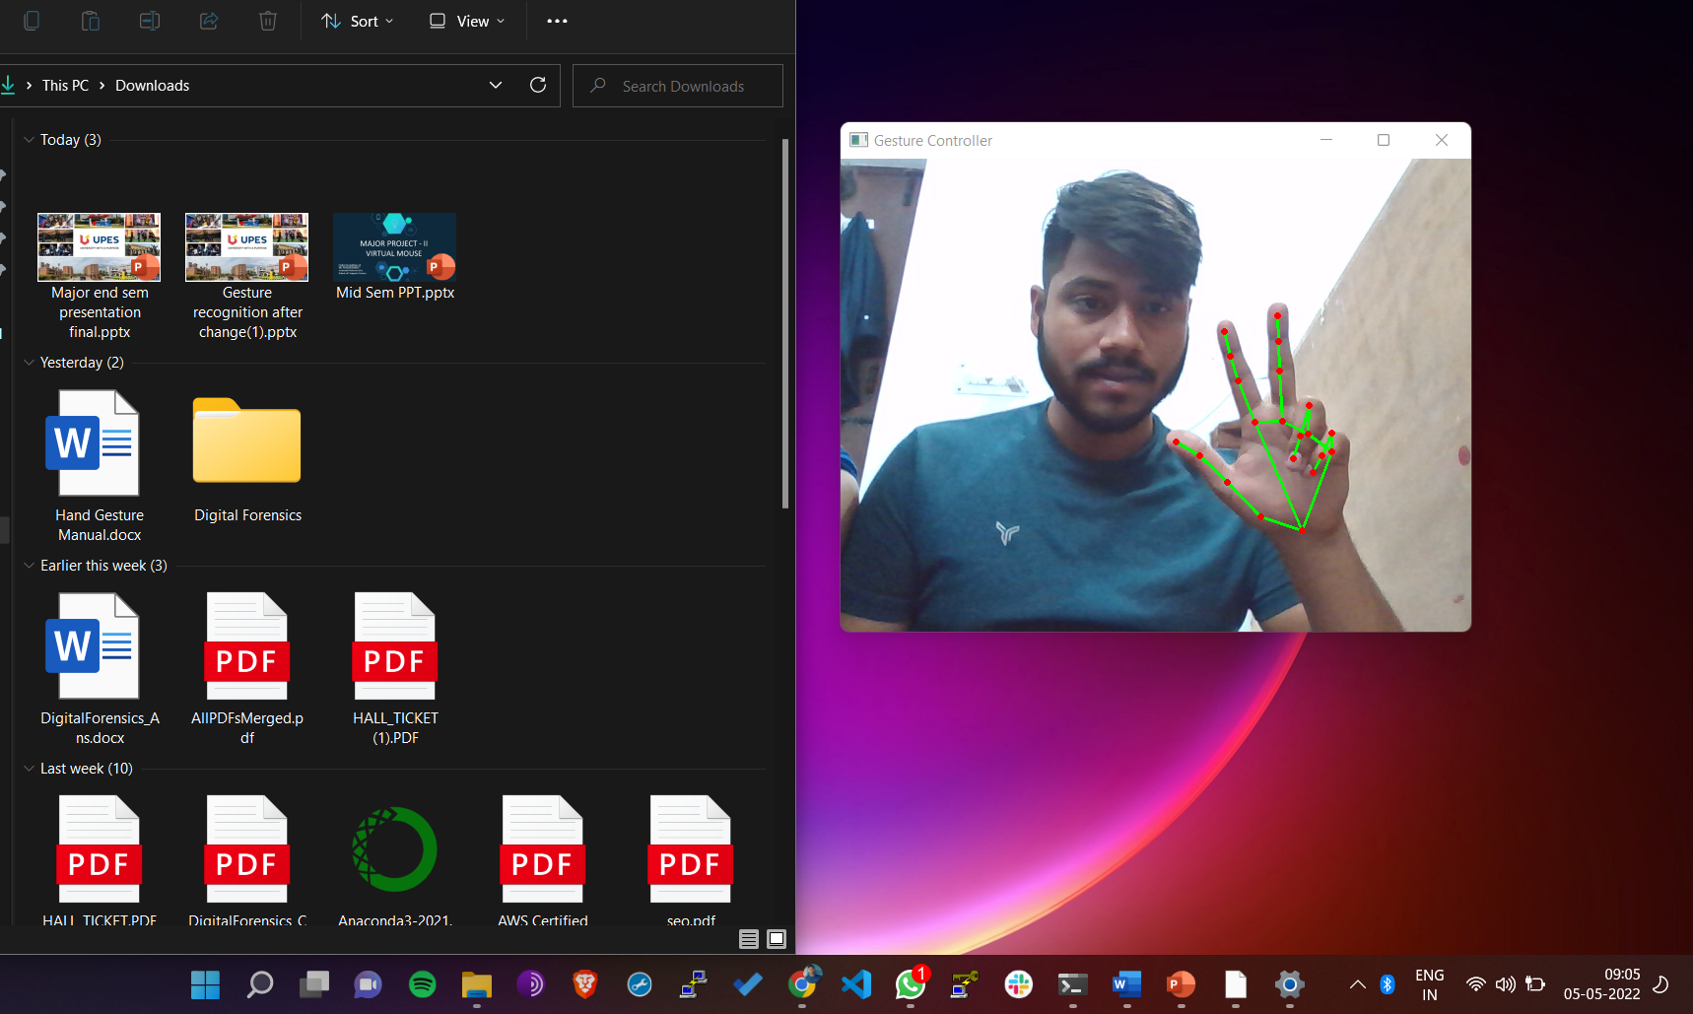
OUTPUT Coordinates

Slide 15
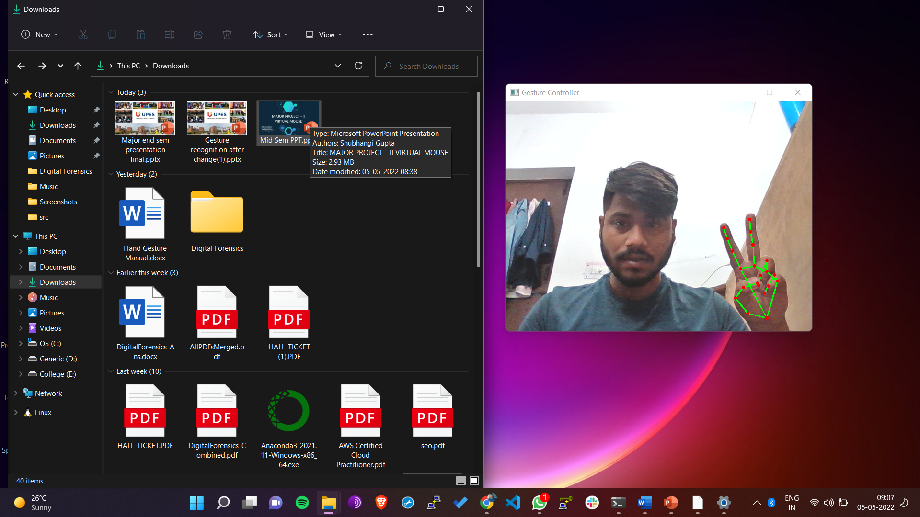
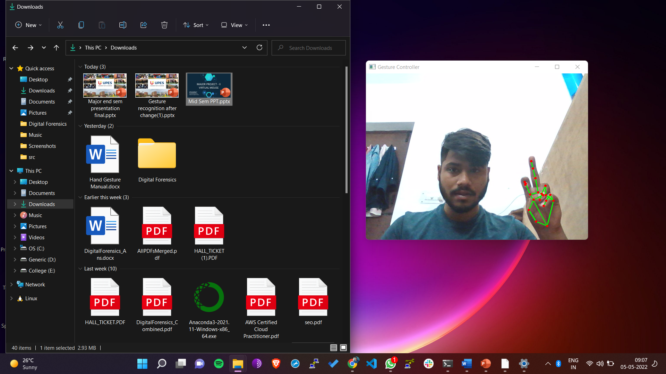
OUTPUT Left Click

Slide 16
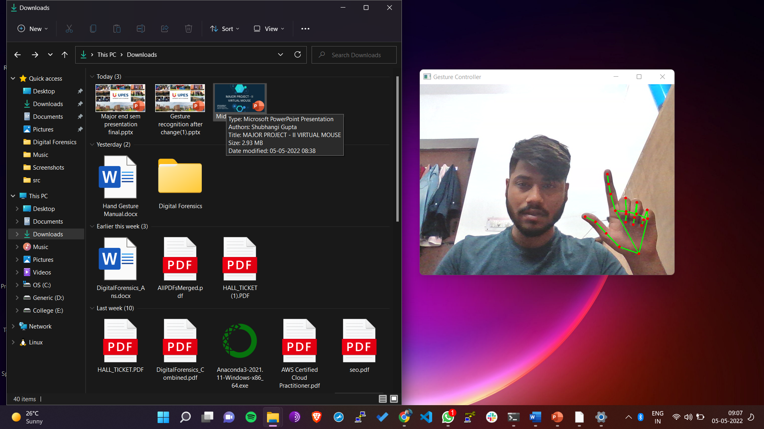
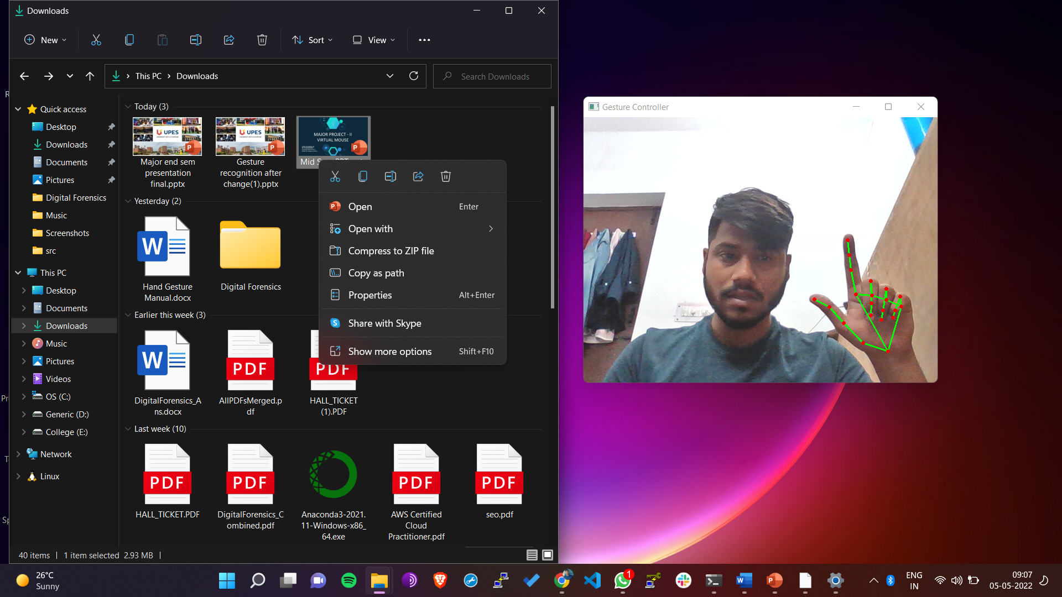
OUTPUT Right Click

Slide 17

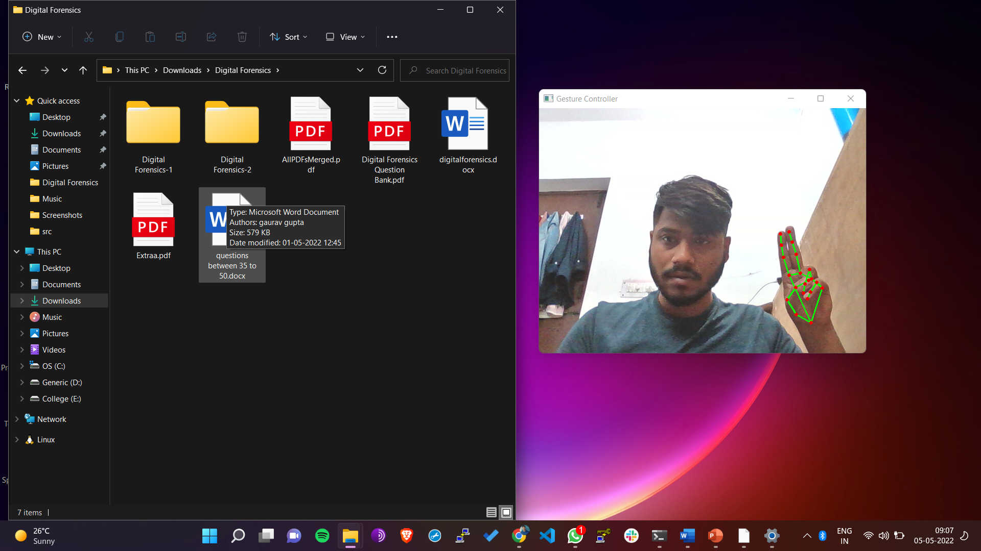
OUTPUT Double Click

Slide 18
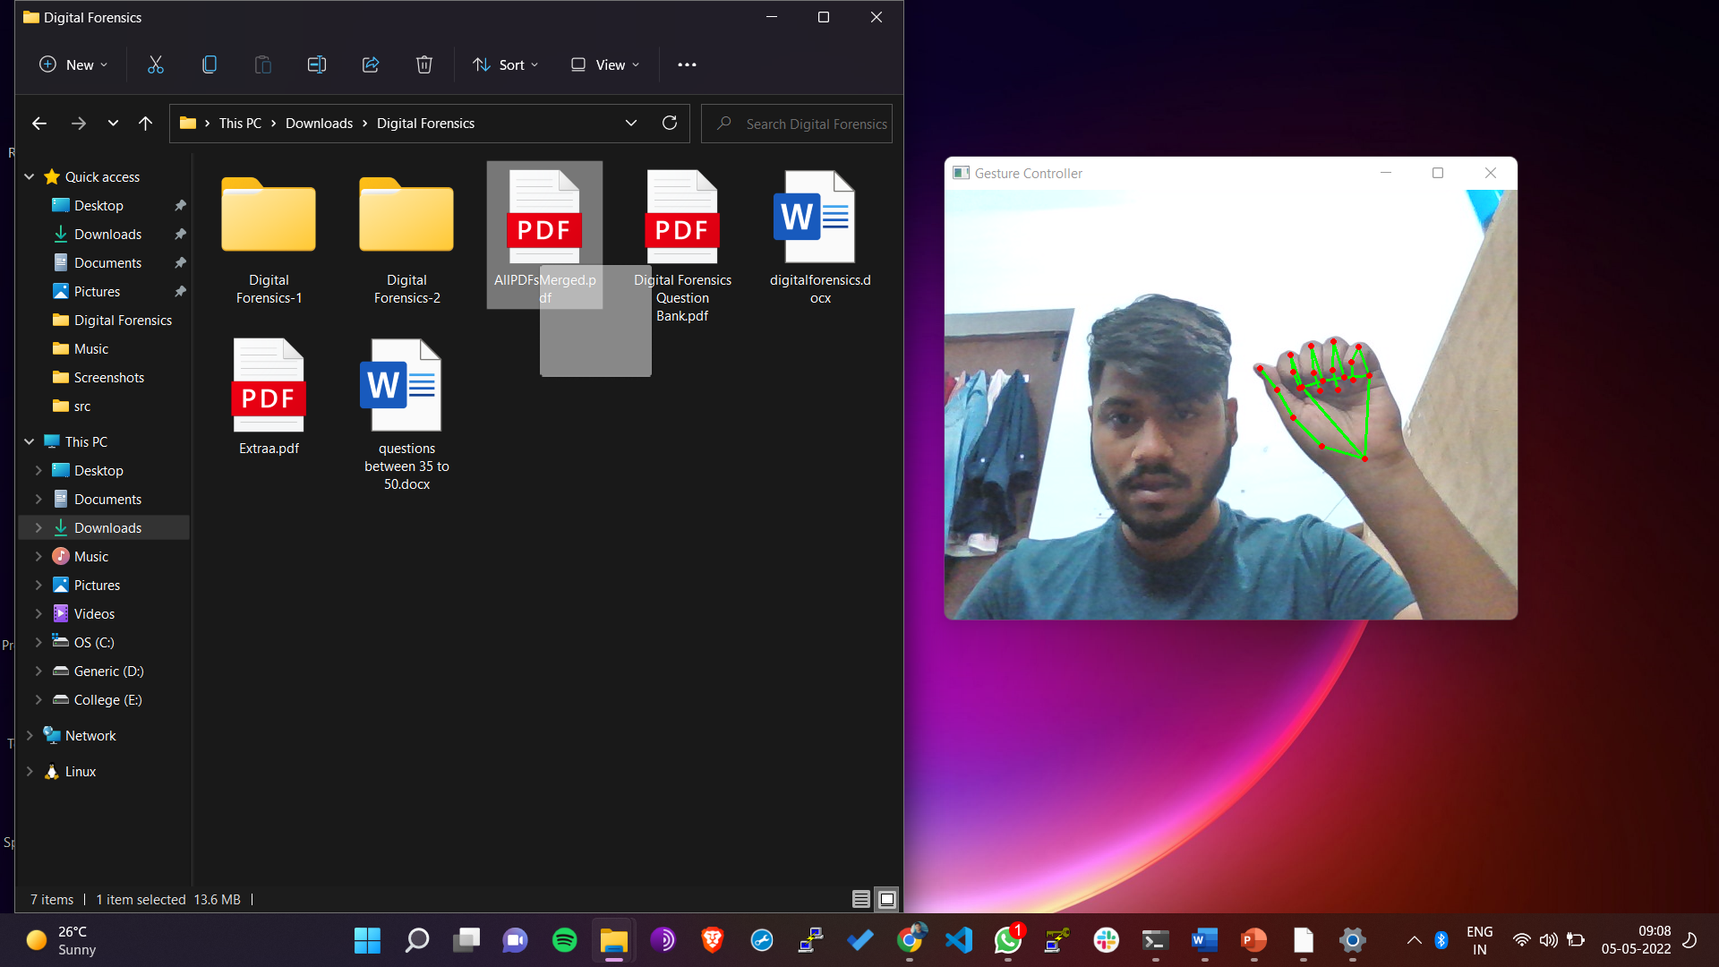
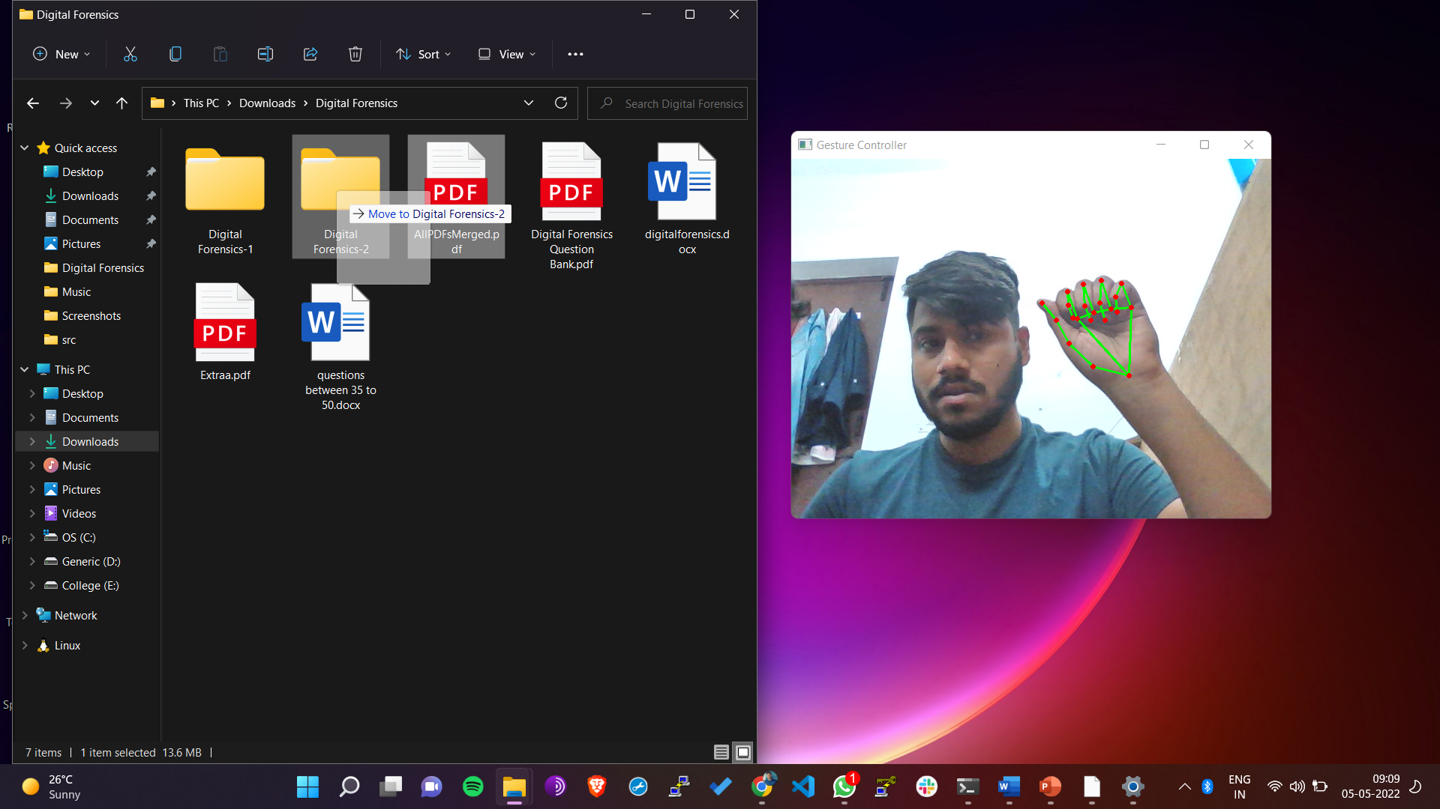
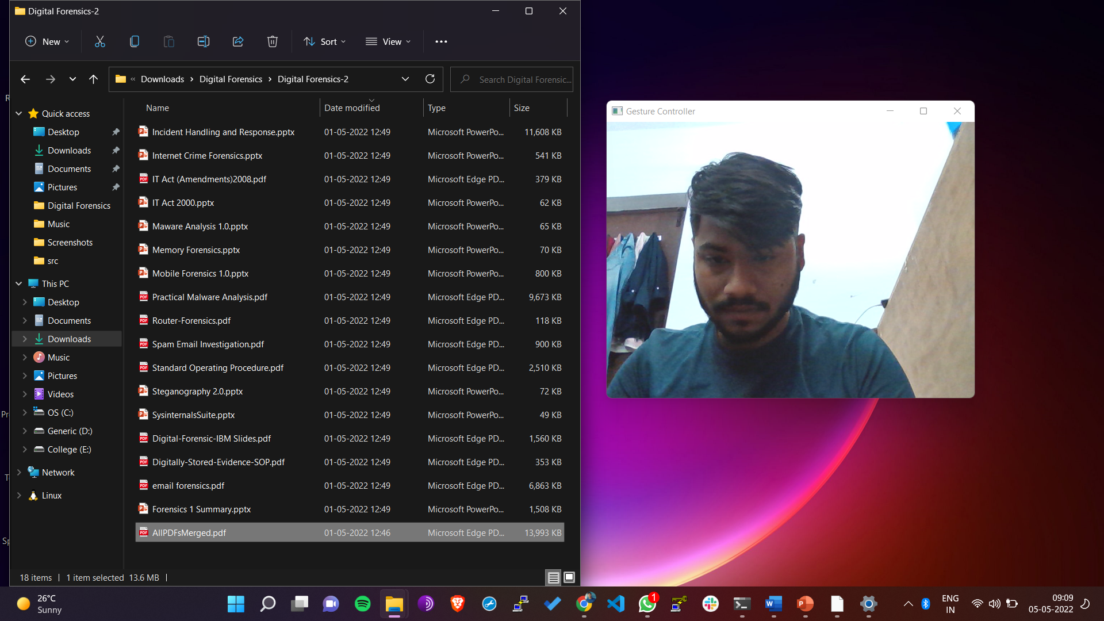
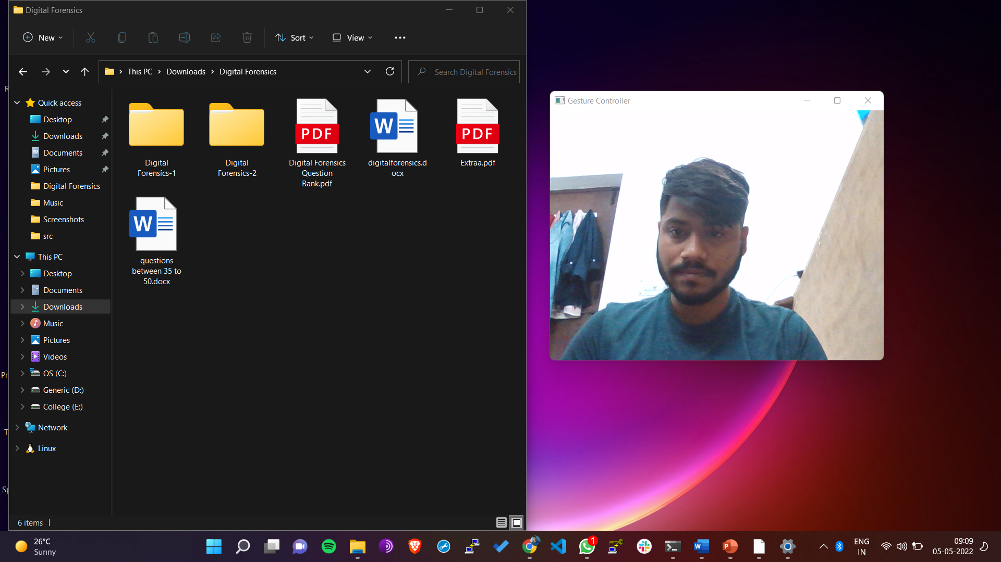
OUTPUT Drag

Slide 19
REFERENCES
1. Zhigang, F. Computer gesture input and its application in human computer interaction. Mini Micro Syst.
1999, 6, 418–421.
2. Mitra, S.; Acharya, T. Gesture recognition: A survey. IEEE Trans. Syst. Man Cybern. Part C Appl. Rev. 2007, 37, 311–324. [CrossRef]
3. Akira Utsumi, TsutoniuMiyasato, Fumio KishinoandRyoheiNakatsu, “Real-time Hand Gesture RecognitionSystem,” Proc. of ACCV ’95, vol. 11, pp. 249-253, Singapore,1995
4.Yikai Fang, Kongqiao Wang, Jian Cheng And Hanqing Lu, A Real- Time Hand Gesture Recognition Method, Â©2007 Ieee

